Slide 1
Books on The MLA Works Cited Page
Fabio Cominotti
EDTECH 513
Boise State University

Slide 2
What you will learn
By the end of this lesson, you will be able to properly format entries for books on the works cited page according to MLA style.
Notes:
The format is important for your readers. It allows them to quickly locate information that will allow them to find your source material.

Slide 3
Required Elements
The following pieces of information should be collected for each book.
Author's Name
Title of the Book
The City of Publication
The Medium of Publication
The Publisher
The Date of Publication
Notes:
For books, these are the general required elements. Some books might also require page number ranges or have multiple authors.

Slide 4
How to Create the Entry Using Microsoft Word
The first thing you must do is type your text.
Place each piece of information in the proper order.
1.) Author's Name
2.) Title of Book
3.) City of Publication
4.) Publisher
5.) Date of Publication
6.) Medium of Publication
Notes:
You'll notice how the entry is still not properly formated. We'll get to that in a minute. Also the city is two words and split betwen lines. This is okay.

Slide 5
Achieving the Proper Format
Type in and select your Text.
Notes:
I used the latest edition of Microsoft Word. Please type your text and select it by whatever means you prefer.

Slide 6
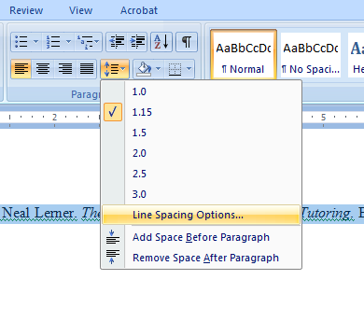
Achieving the Proper Format
Open the Format Dialogue Box
Select Line Spacing
Options
Notes:
Click on the the down pointing arrow next to the line spacing button on the tool bar and then click on Line spacing options to open the format dialogue box.

Slide 7
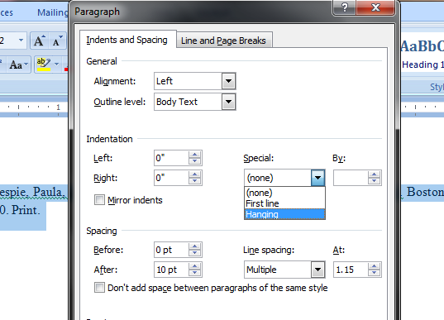
Hanging Indent
Select the Hanging Indent
Notes:
Once the paragraph format dialogue box is open, in the indentation area, select the drop down box labeled "Special" and choose the "hanging" option. This will give your entry the proper hanging indent option.

Slide 8
You're Done
Now you can move onto the next entry.
Notes:
Now you're done with that entry. You can move on. Remember to alphabatize your entries.

